Slide 1
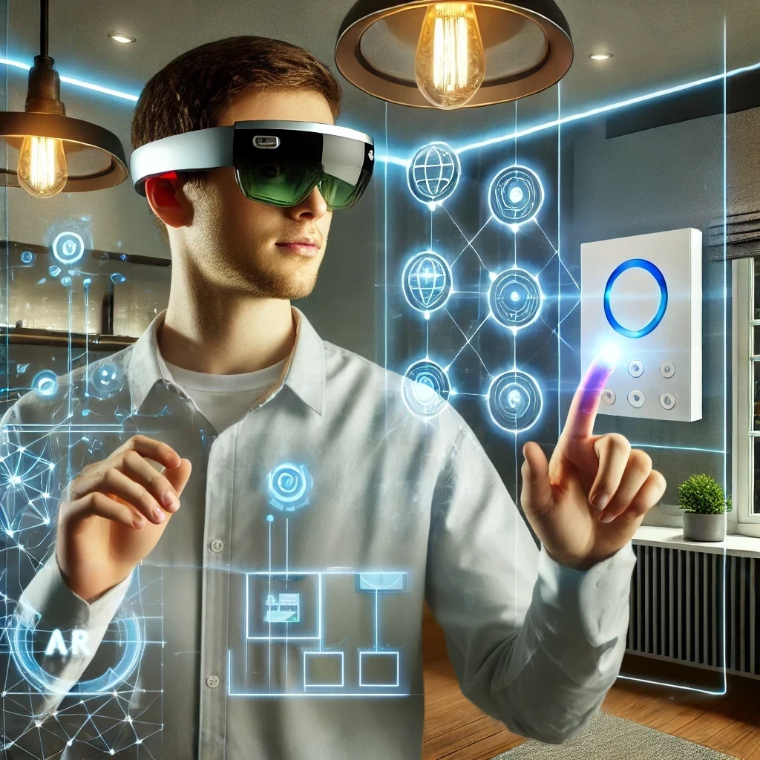
Immersive Web of Things Applications in Mixed Reality
M.Sc. Fady Salama –Research Associate at ESI TUM
M.Sc. Roman Binkert – Research Associate at ESI TUM

Slide 2

Motivation
Foto: Tim Reckmann via ccnull.de
Notes:
How would you instruct this device to lower the pressure?

Slide 3
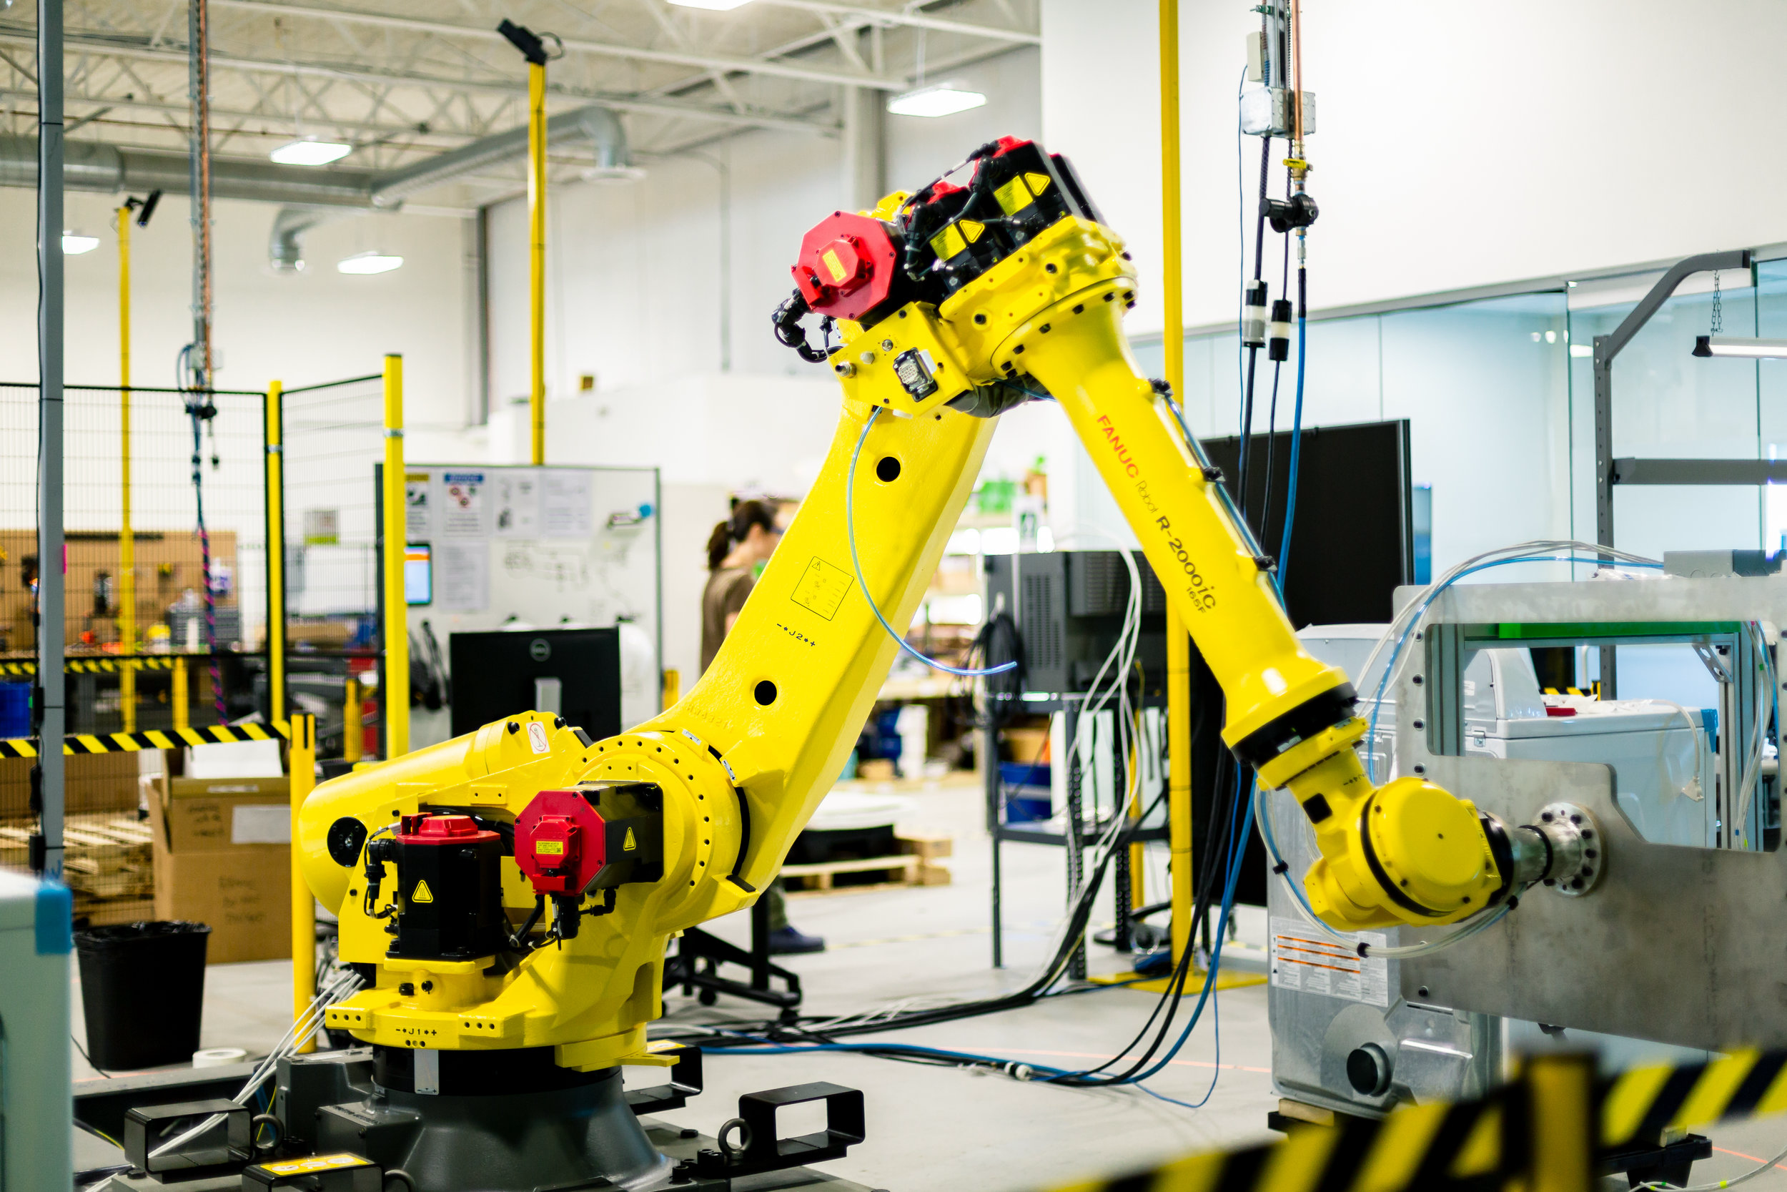
Motivation
Sobalvarro, P. (2018, October 30). The Factory as a Machine. Veo Robotics. Retrieved from https://www.veobot.com/blog/2018/10/30/the-factory-as-a-machine
Notes:
How would you instruct this device to lower the pressure?

Slide 4

Motivation
"Innovation in der digitalen Landwirtschaft" by Marco Verch via ccnull.de, CC-BY 2.0

Slide 5









Problem Statement
Smart Agriculture
A lack of a universal cross-domain application for immersive XR/MR visualization and interactions!
Smart Factories
Smart Home

Slide 6
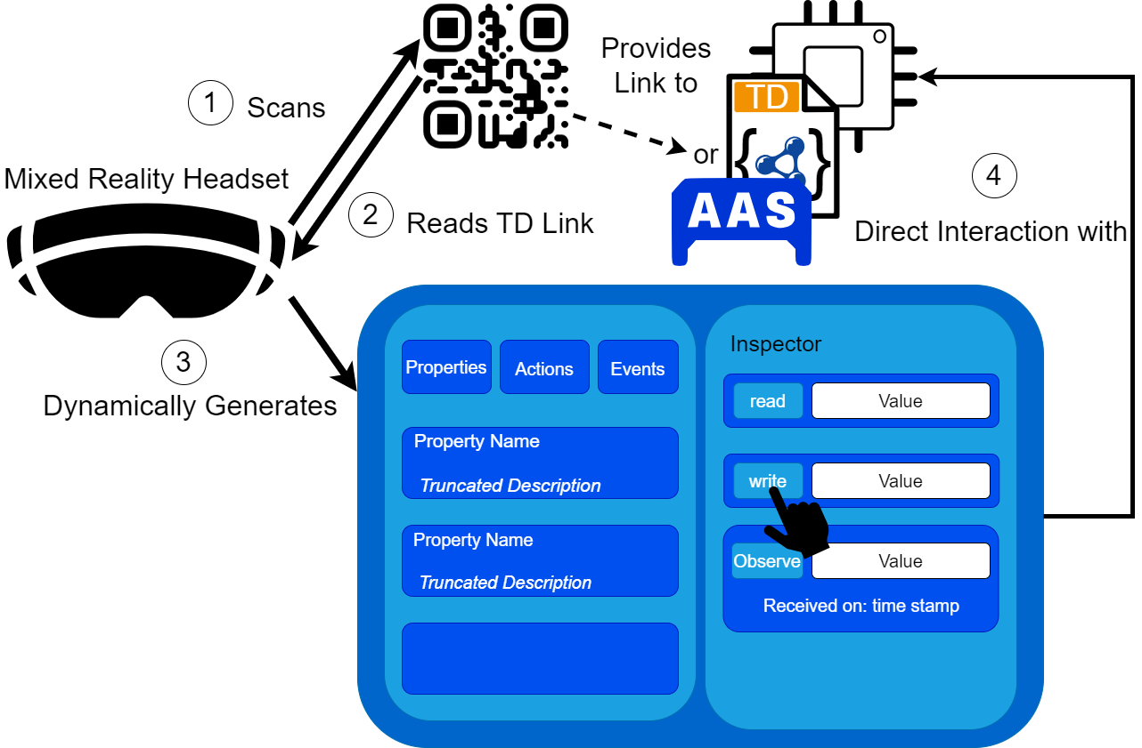

Idea Approach
XR Application: HoloWoT
Immersive, seamless, user-centric
Cross-Platform compatibility
Dynamic UI generation in runtime
No intermediaries between XR device and IoT device
Connectivity established through the Web of Things (WoT)
Notes:
To address this limitation, we introduce a proof-of-concept application called HoloWoT. Demonstrates the potential and feasibility in this approach.
Its objective is to render interaction immersive, seamless, and user-centric.
And we did not spesificly designed and implemented it targeting for HoloLens but we aim to be able to use it other XR devices and headsets.
It provides direct interact with the targeted devices without any intermediaries such as cloud access requirements.
Connectivity between the XR device and the IoT devices was established through the Web of Things (WoT) standards.

Slide 7


Project Details
Communication
Interaction
Notes:
The implementation of the project has two parts: communication part and the Interaction part.

Slide 8





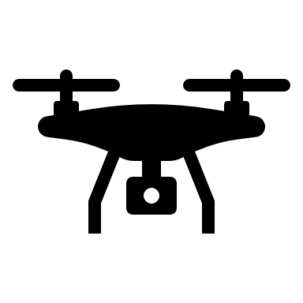

Web of Things
Goal: Enhance IoT interoperability by applying standardized Web technologies

Slide 9
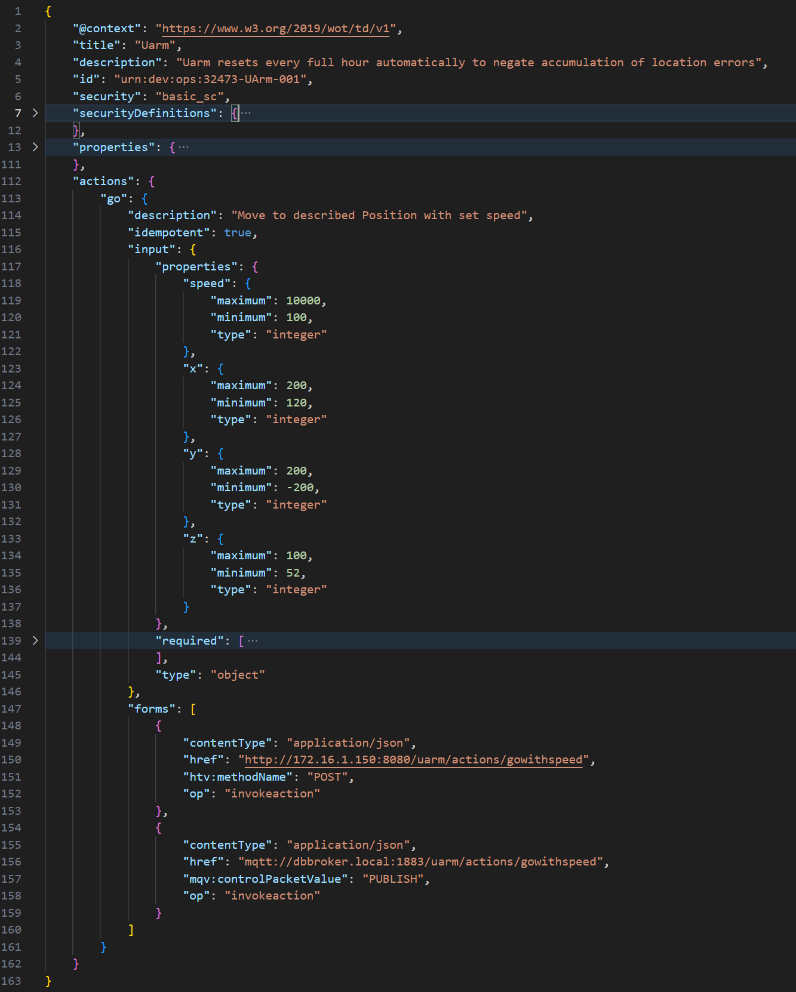
WoT Thing Description
Interaction Affordances:
Property
Action
Event
General Metadata
Data Schemas

Slide 10
WoT Thing Description
Forms & Protocol Bindings
Match Interaction Affordance to actual, protocol-specifc request
10

Slide 11
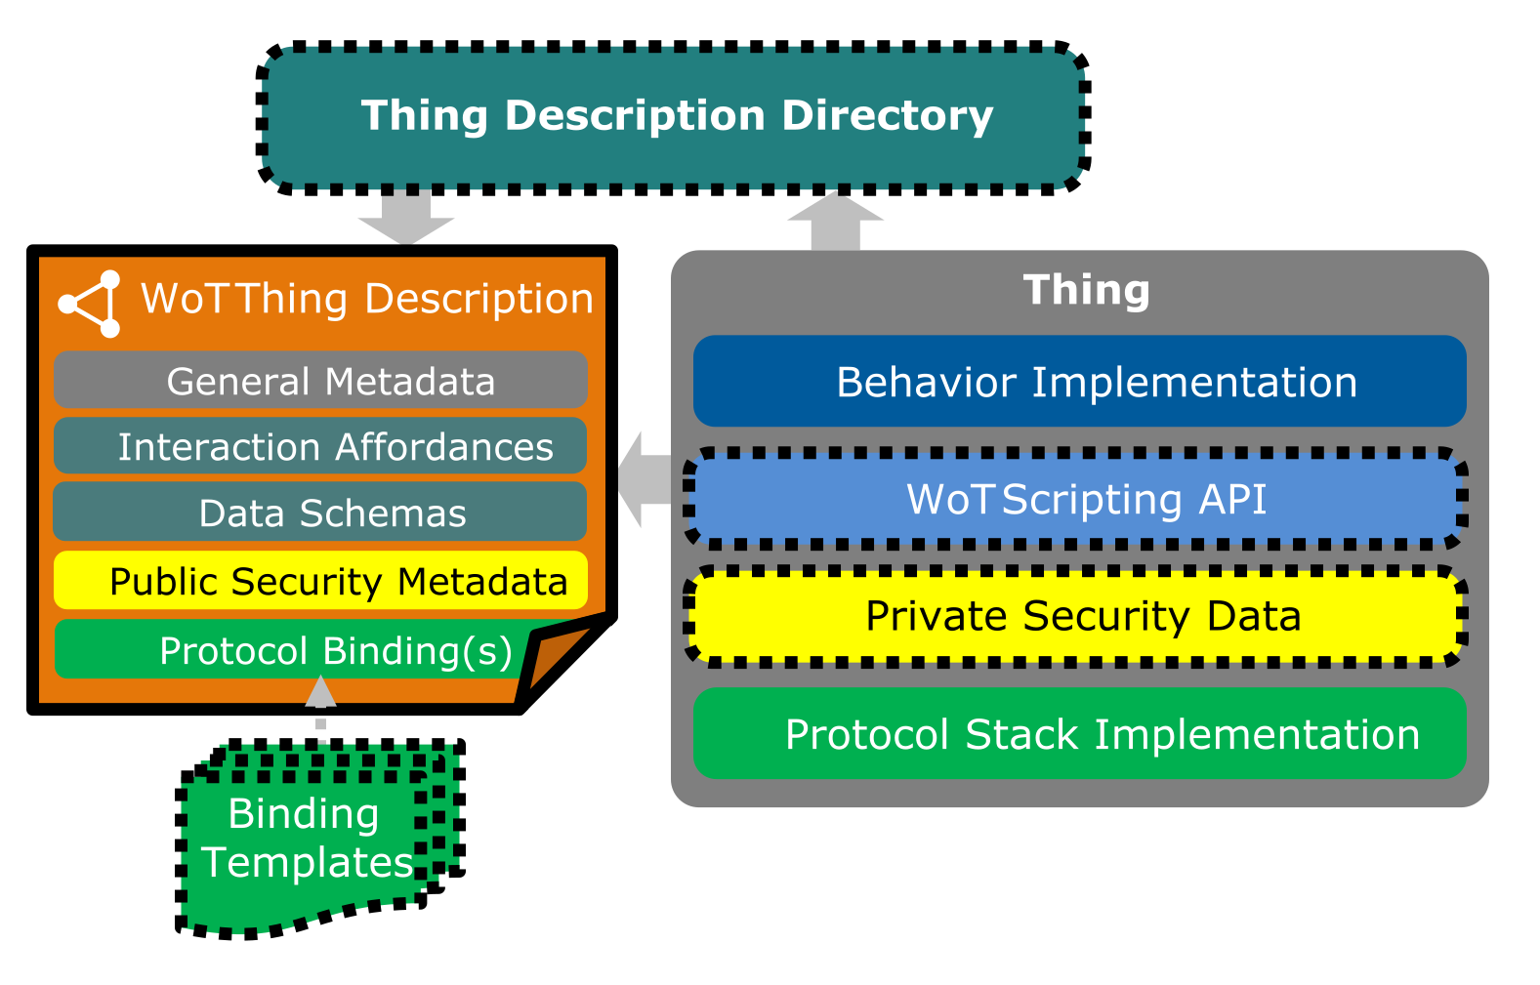
Web of Things: Building Blocks
https://www.w3.org/TR/wot-architecture11/

Slide 12
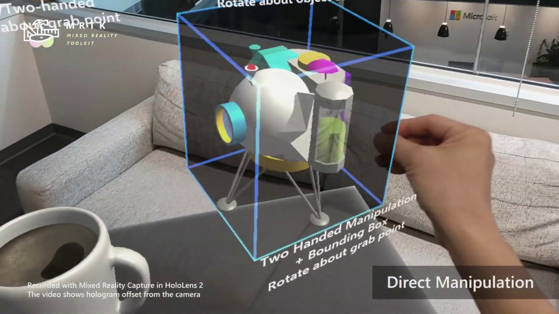
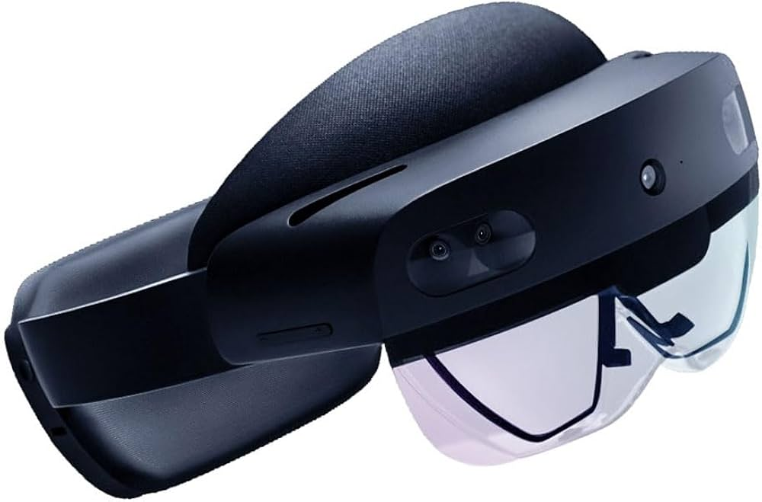
Microsoft Hololens 2
AR Headset
Holographic overlay
Interaction via gesture, voice, eye tracking
Mapping of environment
https://learn.microsoft.com/de-de/windows/mixed-reality/develop/unity/galaxy-explorer-update

Slide 13
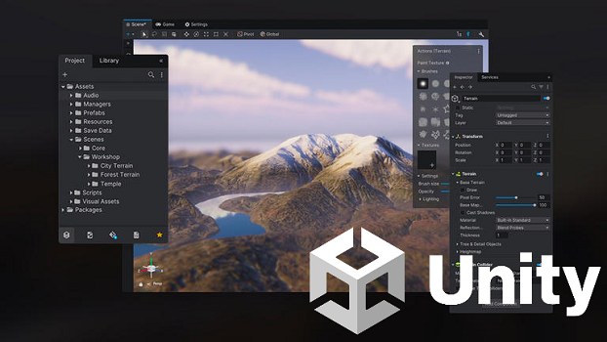
Hololens Programming
Unity
Cross-platfrom game engine
Game Objects in Scenes
C# Scripts
Mixed Reality Toolkit (MRTK)
Spatial awareness and holographic anchors
Gesture recognition and hand tracking
openXR plugin for cross-platform compatibility
https://dotnet.microsoft.com/en-us/apps/games/unity

Slide 14

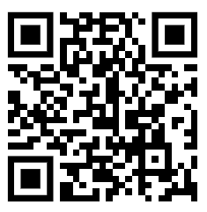
Project Details
Communication: WoT.Net
Deserialize and parse a Thing Description
Handle HTTP/S Request
Handle basic security scheme
.NET Standard 2.0
Open-source
Source Code available in https://github.com/tum-esi/WoT.Net
Notes:
, called WoT.NET,
It is a WoT library in C# programming language. WoT is available in many other languages like Node.js, java etc. since the application is buışt on .NET platform we needed such library.
for parsing, deseriealizing Thing Descriptions, and managing HTTP requests.
(not spesificly for this project but for anyone who inted to built c# application with wot)
While WoT-Definitions.cs contains all the class definitions required for defining the ThingDescription class as described in the TD Specification, TDHelpers.cs contains all the customized converters that are needed for an accurate conversion between JSON and C# objects.

Slide 15
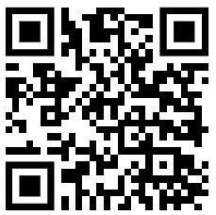
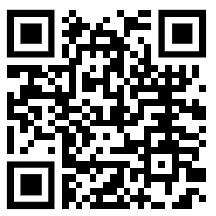
Project Details
WoT.Net.Core
WoT.Net.Binding.Http
WoT.Net.Binding.Coap
WoT.Net.Binding.Mqtt
WoT.Net.Binding.XYZ
What is currently implemented:
WoT.Net.Core → https://www.nuget.org/packages/WoT.Net.Core
TD Parsing and conversion
WoT Interfaces
Consumer
WoT.Binding.Http → https://www.nuget.org/packages/WoT.Net.Binding.Http
HTTP/S Client
Security

Slide 16
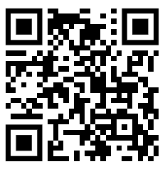
WoT.Net.Core
Documentation: https://tum-esi.github.io/WoT.Net/api/WoT.Core.html
JSON Schema Types | C#
“null” | null
“boolean” | bool
“integer” | integer
“number” | double
“string” | string
“array” | List<T>
“object” | Dictionary<string,T>
Notes:
, called WoT.NET,
It is a WoT library in C# programming language. WoT is available in many other languages like Node.js, java etc. since the application is buışt on .NET platform we needed such library.
for parsing, deseriealizing Thing Descriptions, and managing HTTP requests.
(not spesificly for this project but for anyone who inted to built c# application with wot)
While WoT-Definitions.cs contains all the class definitions required for defining the ThingDescription class as described in the TD Specification, TDHelpers.cs contains all the customized converters that are needed for an accurate conversion between JSON and C# objects.

Slide 17
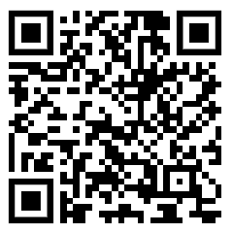
WoT.Net.Binding.Http
Documentation: https://tum-esi.github.io/WoT.Net/api/WoT.Binding.Http.html
Notes:
, called WoT.NET,
It is a WoT library in C# programming language. WoT is available in many other languages like Node.js, java etc. since the application is buışt on .NET platform we needed such library.
for parsing, deseriealizing Thing Descriptions, and managing HTTP requests.
(not spesificly for this project but for anyone who inted to built c# application with wot)
While WoT-Definitions.cs contains all the class definitions required for defining the ThingDescription class as described in the TD Specification, TDHelpers.cs contains all the customized converters that are needed for an accurate conversion between JSON and C# objects.

Slide 18
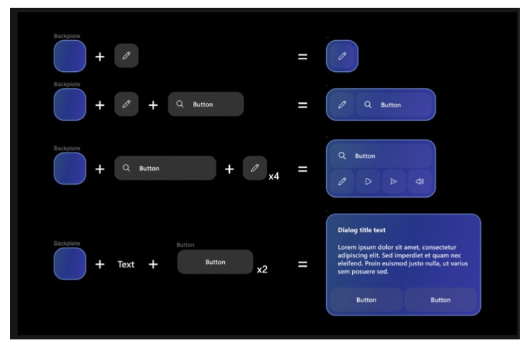
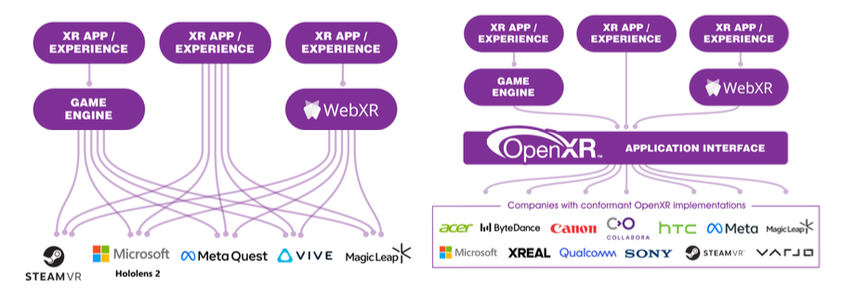
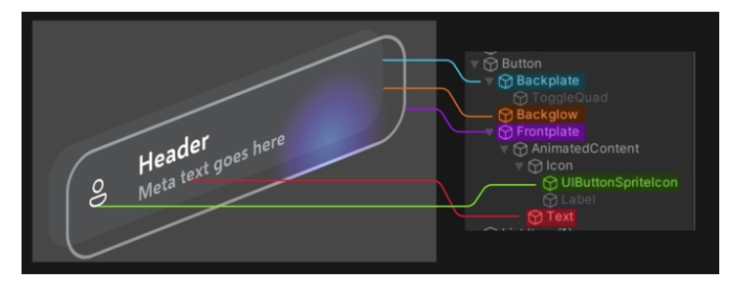
Project Details
Interaction: XR Application
Developed in Unity, C#
Device and platform agnostic (OpenXR)
Microsoft Mixed Reality Tool Kit 3 (MRTK3)
Canvas Based UI elements
QR Code Detection and Tracking
Interaction specific prefabs
Notes:
OpenXR is an application interface that allows the application to operate on any system and device.
It stands as a fundamental element in this application’s development, offering an input system and foundational elements for spatial interactions, including buttons, sliders, slates, and more.
The canvas-based components are dynamically resizable in real-time, with automatic adjustments to margin and padding. It is important for us because our UI is dynamically generated for each unique TD.

Slide 19

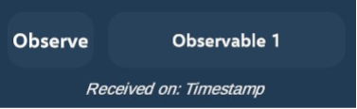
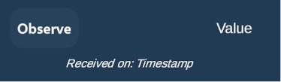

UI Prefabs
Notes:
For all operations and all input types.

Slide 20
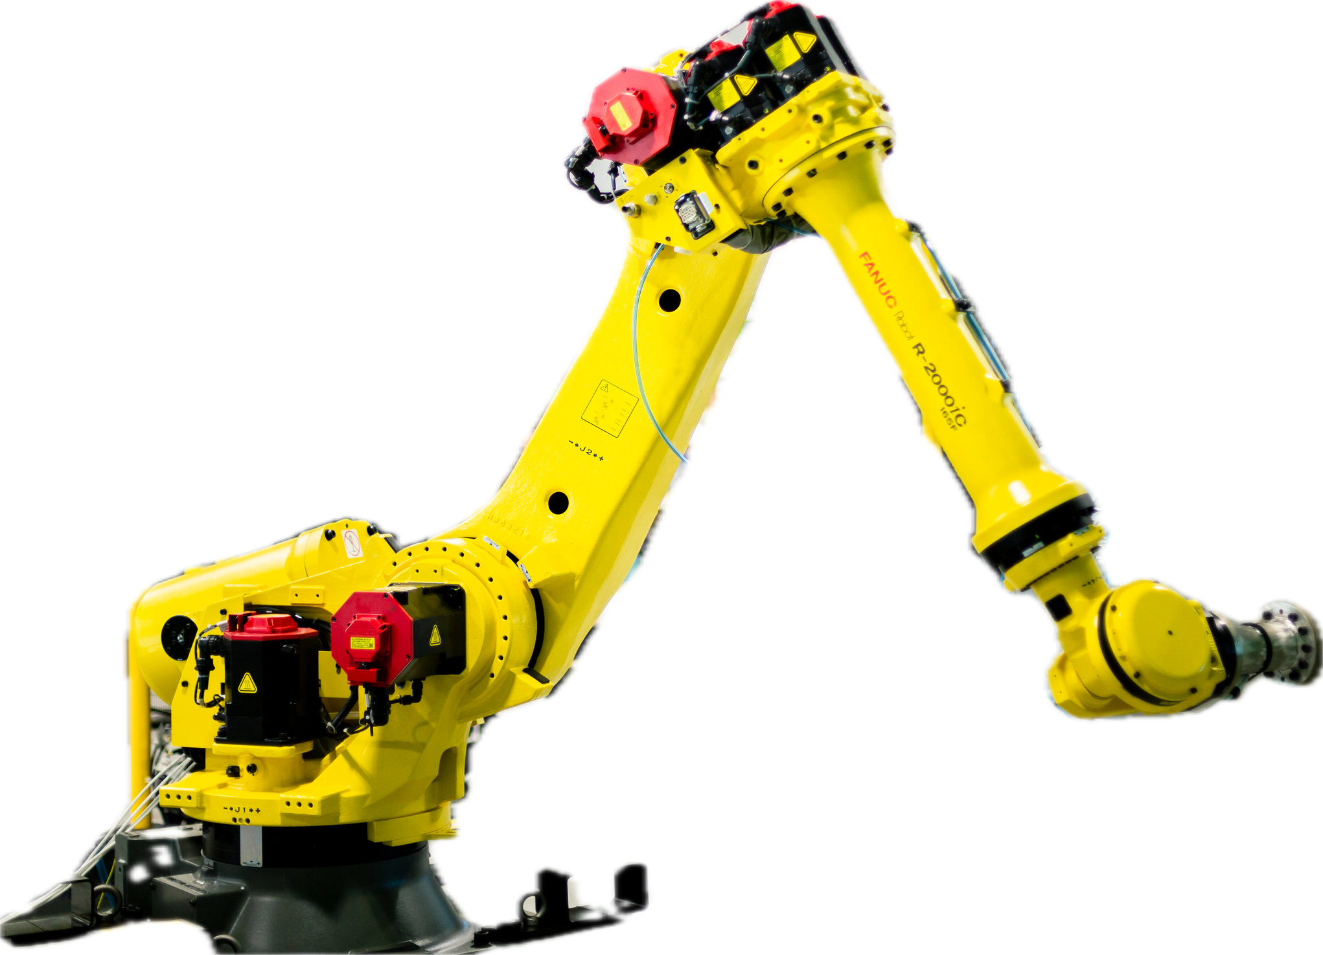
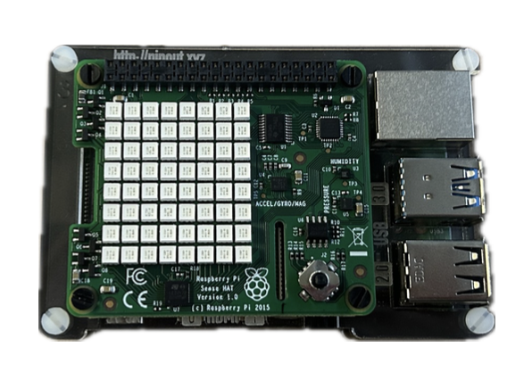
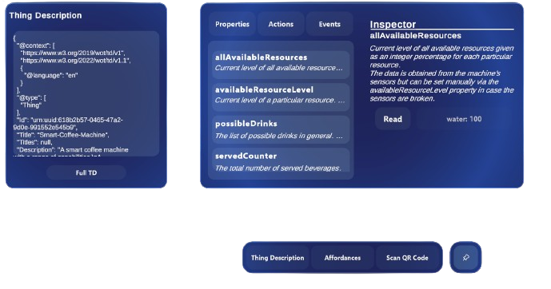

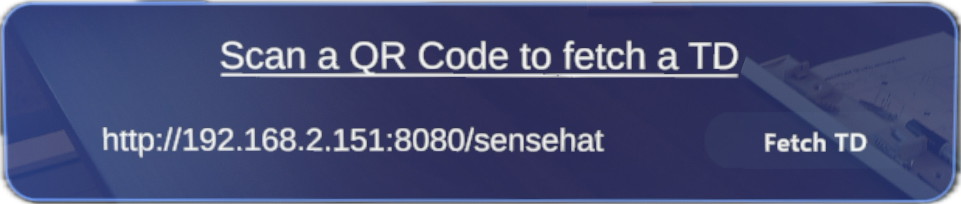
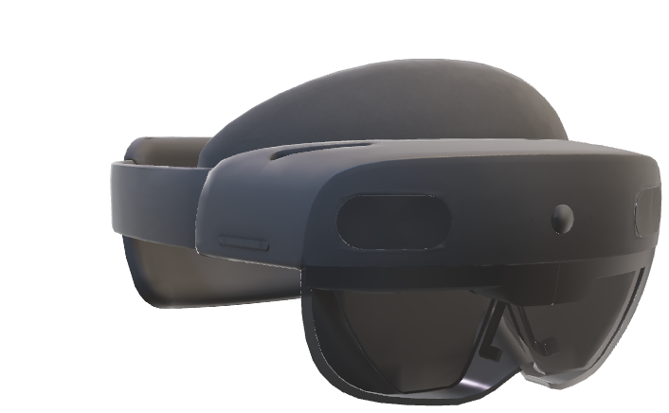
Application Flow
Notes:
How we envision HoloWoT expenrience:
Each device has a unique QR code that has a URL of the Thing Description of the device. TD is the entry point to the device.
User scans the QR code and fetch the TD. Hololens serves as a consumer.
Then the dynamically generated UI is pop up and visualize the device’s interaction affordances such as properties actions and event.
.

Slide 21
Application Flow
Demo Video: Please see the video on the WoT CG YouTube
Notes:
How we envision HoloWoT expenrience:
Each device has a unique QR code that has a URL of the Thing Description of the device. TD is the entry point to the device.
User scans the QR code and fetch the TD. Hololens serves as a consumer.
Then the dynamically generated UI is pop up and visualize the device’s interaction affordances such as properties actions and event.
.

Slide 22
HoloWoT 2.0 – Bring Mashup to Mixed Reality
How could we design an accessible, scalable, low-code IoT orchestration framework using the Web of Things (WoT) standard?
Notes:
OpenXR is an application interface that allows the application to operate on any system and device.
It stands as a fundamental element in this application’s development, offering an input system and foundational elements for spatial interactions, including buttons, sliders, slates, and more.
The canvas-based components are dynamically resizable in real-time, with automatic adjustments to margin and padding. It is important for us because our UI is dynamically generated for each unique TD.

Slide 23
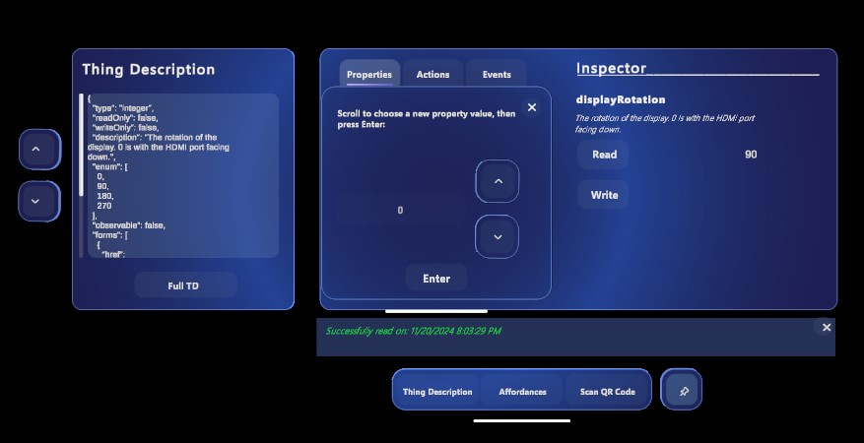
Approach – UI Improvements
Separation of concerns!

Slide 24
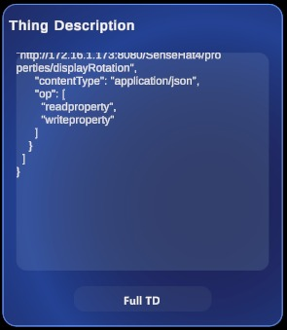
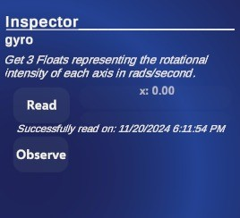
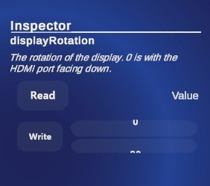
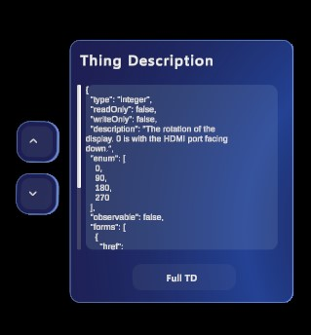
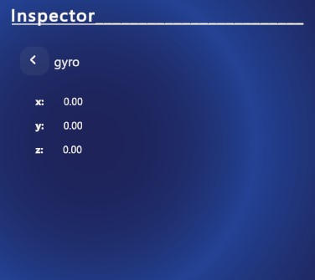
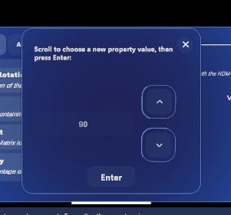
Approach – UI Improvements
Sticky Scrollable Panel
Nested Data Structures
Selecting an Input

Slide 25
Approach – Mashup Creation
Gripper Robot
Pick Object from Warehouse
Drop Object at Oven
Oven
Start Baking + Input (e.g. 5 sec)
Sorting Line
Sort Product into red/blue/white
Trigger Condition
If product is Red
Pick Object from Red Position
Drop Object at …

Slide 26
Approach – Mashup Creation
Demo Video: Please see the video on the WoT CG YouTube

Slide 27
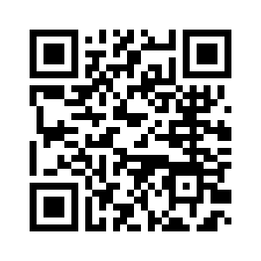
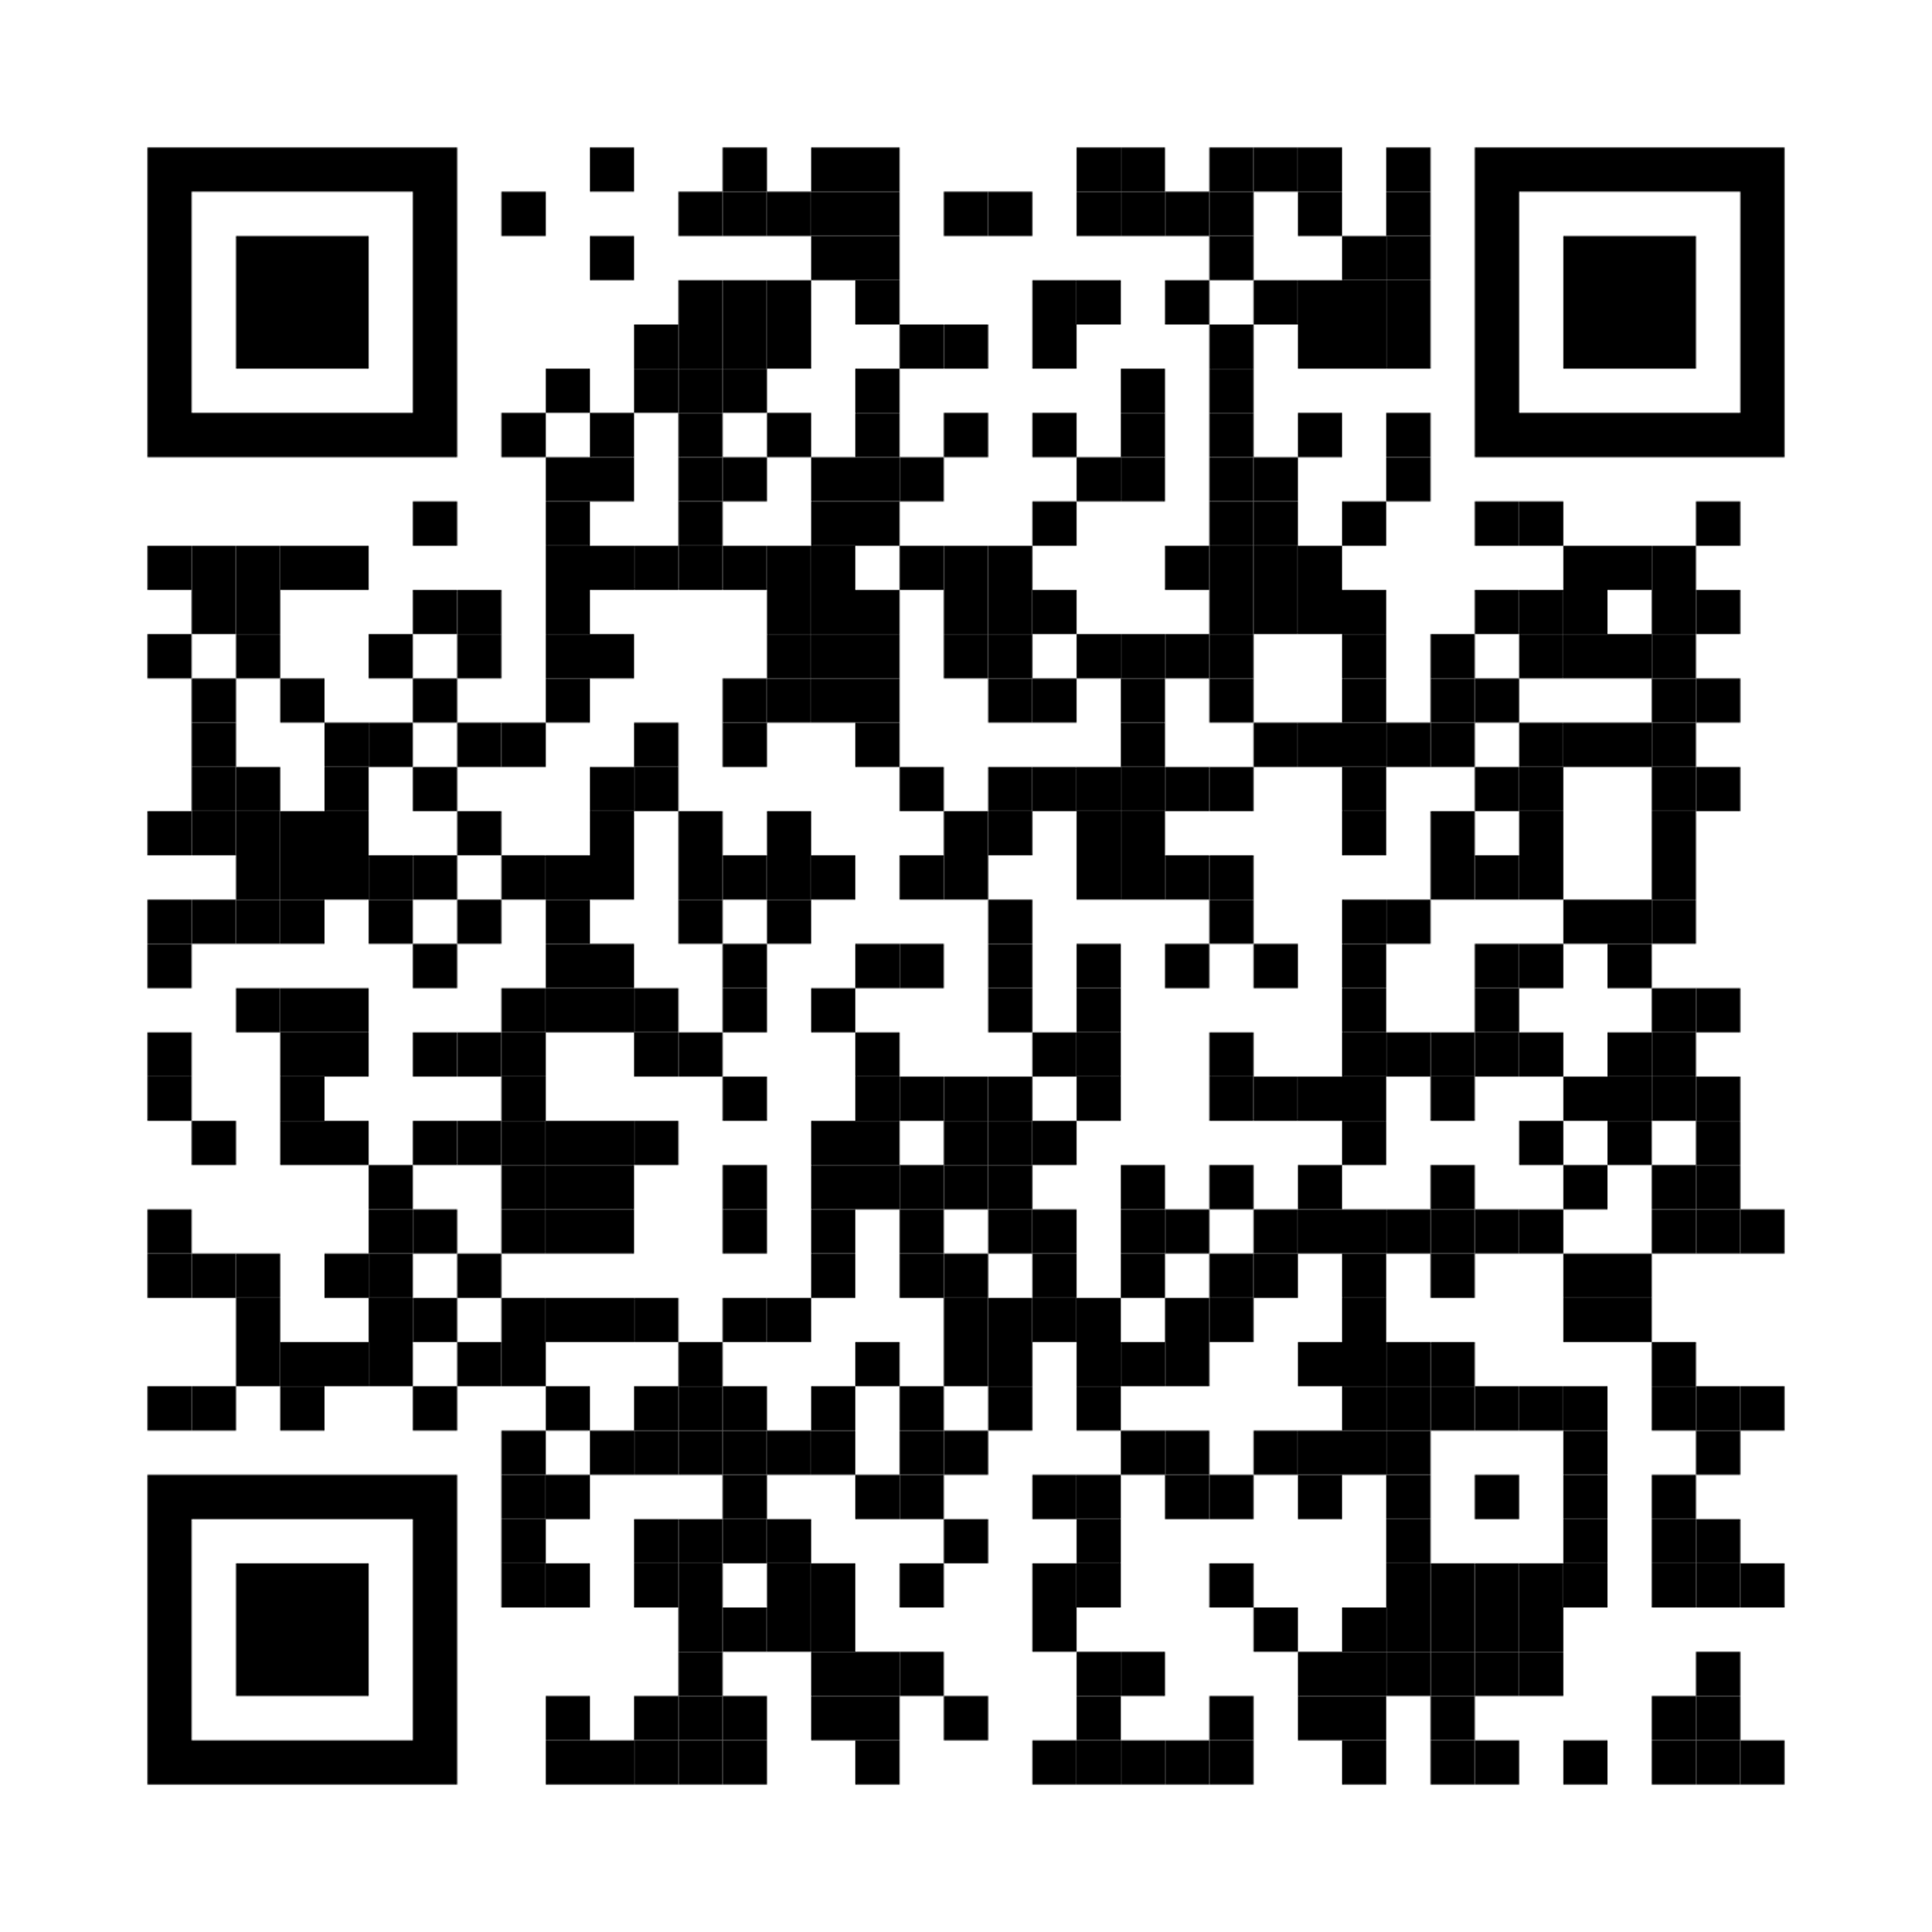
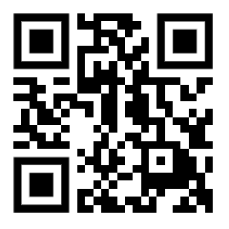
Thank you for your attention
Contact Details:
Fady Salama
Research Associate
Associate Professorship of Embedded Systems and Internet of Things
School of Computation, Information and Technology
Technical University of Munich
E-Mail:
fady.salama@tum.de
roman.binkert@tum.de
Homepage
Email: Fady Salama
Email: Roman Binkert

